Slide 1
MIT 6.875
Foundations of Cryptography
Lecture 7

Slide 2
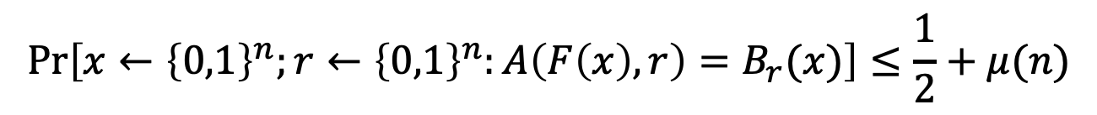
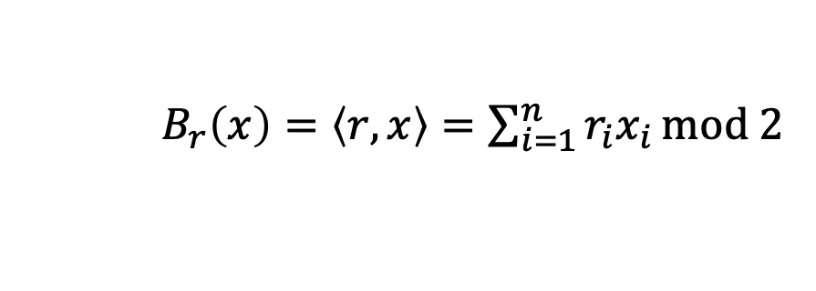
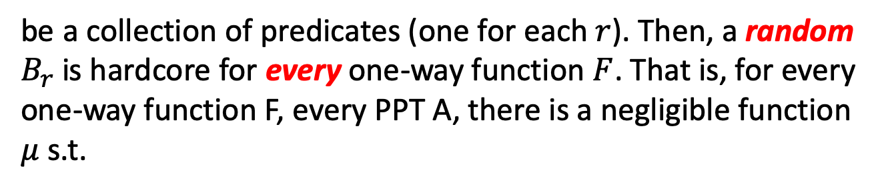
The Goldreich-Levin (GL) Theorem
Let ${\{B}_{r}:{\{0,1\}}^{n}→\{0,1\}\}$ where
$B_{r}\left(x\right)=\left\langle r,x\right\rangle =\sum_{i=1}^{n}{r_{i}x_{i}}mod 2$
be a collection of predicates (one for each $r$). Then, a random $B_{r}$is hardcore for every one-way function $F$. That is, for every one-way function F, every PPT A, there is a negligible function $μ$ s.t.
$$\operatorname{Pr}\left[x←{\left\{0,1\right\}}^{n};r←{\left\{0,1\right\}}^{n}:A\left(F\left(x\right),r\right)=B_{r}(x)\right]≤\frac{1}{2}+μ(n)$$

Slide 3
GL Theorem: Alternative Interpretation
For every one-way function/permutation $F$, there is a related one-way function/permutation
$F^{′}\left(x,r\right)=(F\left(x\right),r)$
which has a deterministic hardcore predicate. In particular, the predicate $B\left(x,r\right)=$ $\left\langle r,x\right\rangle mod 2$ is hardcore for $F^{′}$.
$$\operatorname{Pr}\left[x←{\left\{0,1\right\}}^{n};r←{\left\{0,1\right\}}^{n}:A\left(F′\left(x,r\right)\right)=\left\langle r,x\right\rangle \right]≤\frac{1}{2}+μ(n)$$
Key Point:
This statement is sufficient to construct PRGs from any OWP.

Slide 4
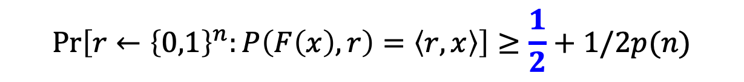
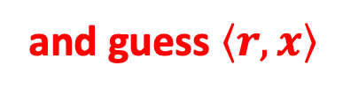

A Proof of the GL Theorem
Assume (after averaging) that for $≥1/2p(n)$ fraction of the $x$,
$$\operatorname{Pr}\left[r←{\left\{0,1\right\}}^{n}:P\left(F\left(x\right),r\right)=\left\langle r,x\right\rangle \right]≥\frac{1}{2}+1/2p(n)$$
Recall the template:
Pick a random $r$, ask P for $\left\langle r+e_{i},x\right\rangle$ and $\left\langle r,x\right\rangle$. Subtract the two to get $\left\langle e_{i},x\right\rangle =x_{i}$.
and guess $\left\langle r,x\right\rangle$

Slide 5
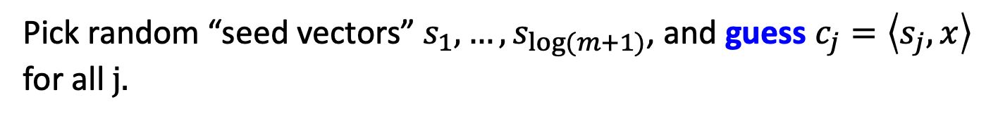
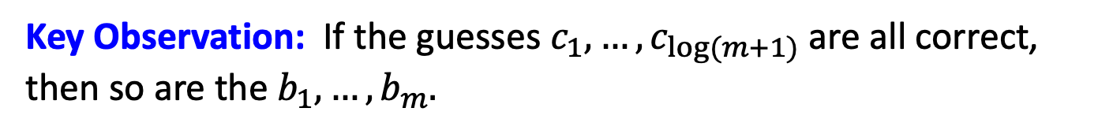
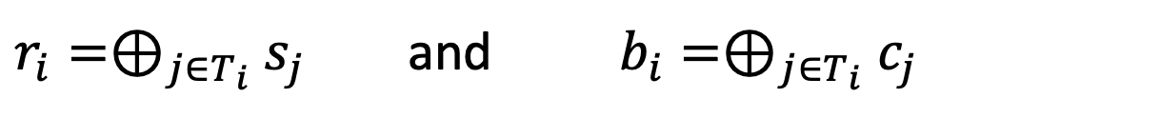
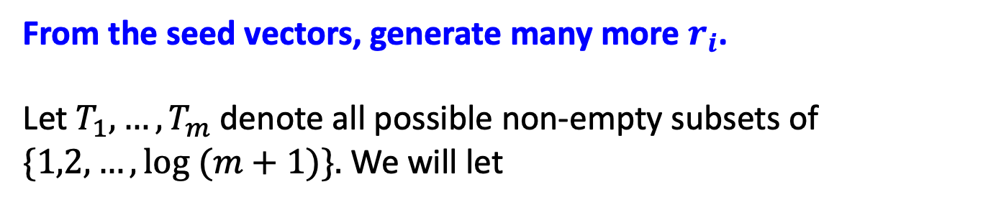
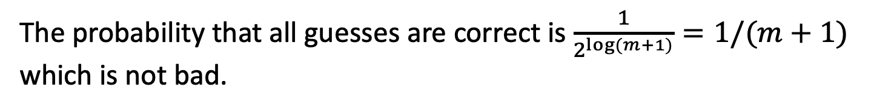
The idea: Parsimony in Guessing
Pick random “seed vectors” $s_{1},…,s_{\log{(m+1)}}$, and guess $c_{j}=\left\langle s_{j},x\right\rangle$ for all$j.$
The probability that all guesses are correct is $\frac{1}{2^{\log{(m+1)}}}=1/(m+1)$ which is not bad.
From the seed vectors, generate many more $r_{i}$.
Let $T_{1},…,T_{m}$ denote all possible non-empty subsets of $\{1,2,…,\log{(m+1)\}.}$ We will let
$r_{i}=⊕_{j∈T_{i}}$ $s_{j}$ and $b_{i}=⊕_{j∈T_{i}}$ $c_{j}$
Key Observation: If the guesses $c_{1},…,c_{\log{(m+1)}}$ are all correct, then so are the $b_{1},…,b_{m}.$

Slide 6


The OWF Inverter
Generate random $s_{1},…,s_{log⁡(m+1)}$ and bits $c_{1},…,c_{log⁡(m+1)}$.
From them, derive $r_{1},…,r_{log⁡(m+1)}$ and bits $b_{1},…,b_{m}$ as in the previous slide.
Repeat for each $i∈\left\{1,2,…,n\right\}$:
Repeat $O(n{\left(p\left(n\right)\right)}^{2})$ times:
Ask $P$ to tells us $\left\langle r_{ij}+e_{i},x\right\rangle$. XOR P’s reply with $b_{i}$to get a guess for $x_{i}$.
Compute the majority of all such guesses and set the bit as $x_{i}$
Output the concatenation of all $x_{i}$ as $x.$

Slide 7
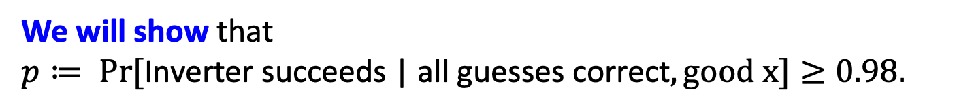
Analysis of the Inverter
Let’s condition on the guesses $c_{1},…,c_{log⁡(m+1)}$ being all correct.
The main issue: The $r_{i}$ are not independent (can’t do Chernoff)
Key Observation: The $r_{i}$ are pairwise independent.
Therefore, can apply Chebyshev!
We will show that
$p≔ Pr⁡[\text{Inverter} \text{succeeds}\text{ | }\text{all} \text{guesses} \text{correct}, good x]≥0.98.$
(We will prove this in a bit, but let’s assume it for now)

Slide 8
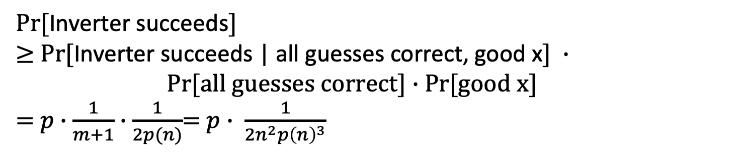
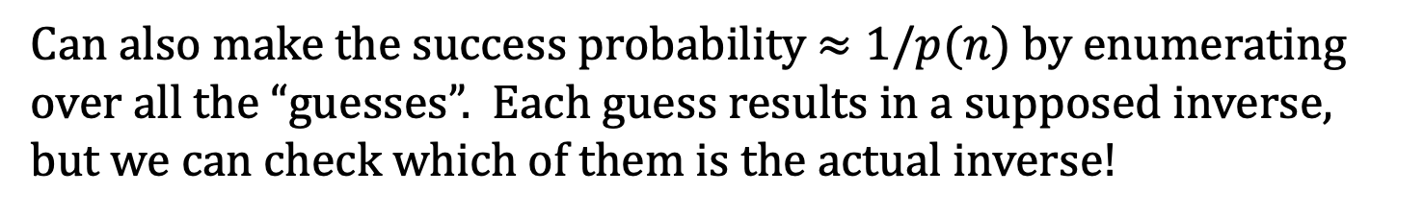
Finishing the proof (assuming p is large)
$Pr⁡[$Inverter succeeds$]$
$≥$ $Pr⁡[$Inverter succeeds | all guesses correct, good x$] ∙$ $Pr[all guesses correct]∙$ Pr[good x]
= $p∙\frac{1}{m+1}∙\frac{1}{2p(n)}$= $p∙ \frac{1}{{2n}^{2}{p\left(n\right)}^{3}}$
So, it suffices to show that $p$is large.
We will now show that $p≥0.98$, so we are done.
Can also make the success probability $≈1/p(n)$ by enumerating over all the “guesses”. Each guess results in a supposed inverse, but we can check which of them is the actual inverse!

Slide 9
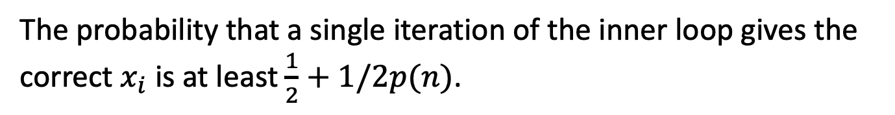

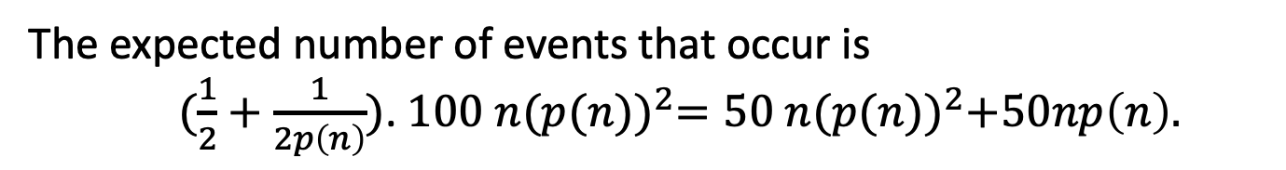
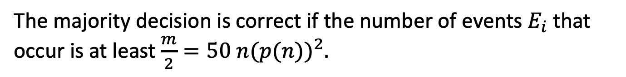
Analysis of the Inverter: Estimating p
The probability that a single iteration of the inner loop gives the correct $x_{i}$ is at least $\frac{1}{2}+1/2p(n)$.
Let this be the good event $E_{i}$ (for the $i^{th}$ iteration of the inner loop).
The majority decision is correct if the number of events $E_{i}$ that occur is at least $\frac{m}{2}=50 n{(p(n))}^{2}.$
The expected number of events that occur is
$(\frac{1}{2}+\frac{1}{2p\left(n\right)})$. $100 n{(p(n))}^{2}=50 n{(p(n))}^{2}+50np\left(n\right).$
The variance is
$≈\frac{1}{2}∙100 n{\left(p\left(n\right)\right)}^{2}=50n{\left(p\left(n\right)\right)}^{2}$

Slide 10
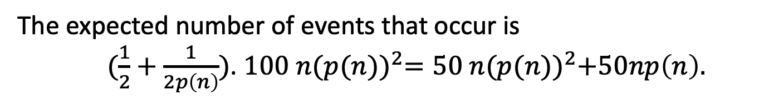

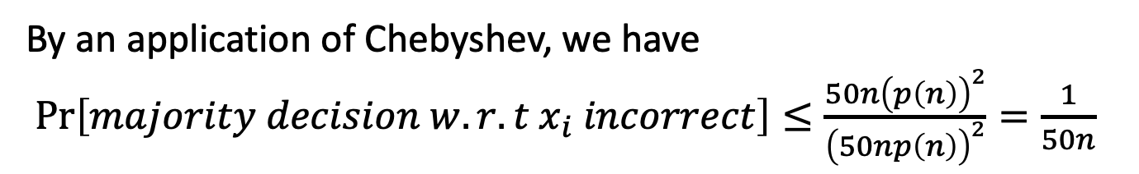
Analysis of the Inverter: Estimating p
The expected number of events that occur is
$(\frac{1}{2}+\frac{1}{2p\left(n\right)})$. $100 n{(p(n))}^{2}=50 n{(p(n))}^{2}+50np\left(n\right).$
The variance is $≈\frac{1}{2}∙100 n{\left(p\left(n\right)\right)}^{2}=50n{\left(p\left(n\right)\right)}^{2}$
By an application of Chebyshev, we have
$\operatorname{Pr}\left[majority decision w.r.t x_{i} incorrect\right]≤\frac{50n{\left(p\left(n\right)\right)}^{2}}{{\left(50np\left(n\right)\right)}^{2}}=\frac{1}{50n}$
By an application of union bound, we have
$\operatorname{Pr}\left[one of the x_{i} is incorrect\right]≤n∙\frac{1}{50n}=1/50$
$∴$ The inverter outputs the correct inverse w.p. $p≥0.98.$

Slide 11
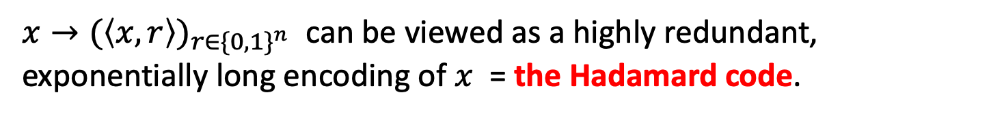
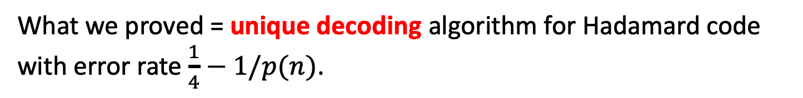
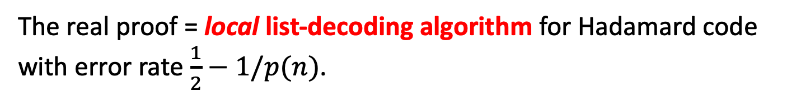
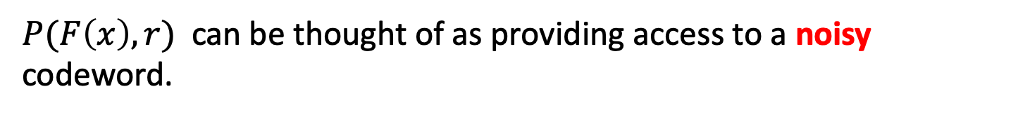
The Coding-Theoretic View of GL
$x→{(\left\langle x,r\right\rangle )}_{r∈{\{0,1\}}^{n}}$ can be viewed as a highly redundant, exponentially long encoding of $x$ = the Hadamard code.
$P(F\left(x\right),r)$ can be thought of as providing access to a noisy codeword.
What we proved = unique decoding algorithm for Hadamard code with error rate $\frac{1}{4}−1/p(n)$.
The real proof = local list-decoding algorithm for Hadamard code with error rate $\frac{1}{2}−1/p(n)$.

Slide 12
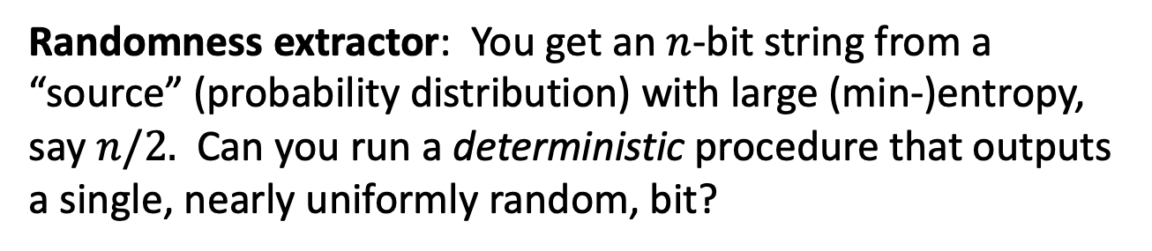
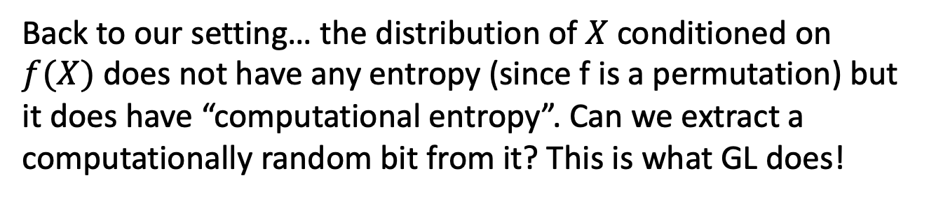
GL as Randomness Extraction
Randomness extractor: You get an $n$-bit string from a “source” (probability distribution) with large (min-)entropy, say $n/2.$ Can you run a deterministic procedure that outputs a single, nearly uniformly random, bit?
This is impossible.
But possible given a short, truly random, “seed”. Leads to an entire theory of randomness extraction.
Back to our setting… the distribution of $X$ conditioned on $f(X)$ does not have any entropy (since f is a permutation) but it does have “computational entropy”. Can we extract a computationally random bit from it? This is what GL does!

Slide 14


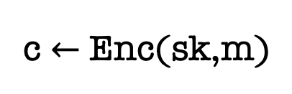
Secret-Key Encryption
(also called symmetric encryption)
m
c $←$ Enc(sk,m)
sk
sk
The Key Agreement Problem:
How did Alice and Bob get the same sk to begin with?!

Slide 15

Secret-Key Encryption
The Key Agreement Problem:
How did Alice and Bob get the same sk to begin with?!
Physical Exchange of Keys is Clunky and Impractical:
What if Alice and Bob have never met in person?
Even so, what if they need to refresh their keys?
Too expensive and cumbersome: Each user will need to store $N$ keys, too expensive!

Slide 16
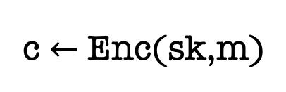
Secret-Key Encryption
c $←$ Enc(sk,m)
sk
sk
The Key Agreement Problem: Can Alice and Bob, who never previously met, exchange messages securely?

Slide 17
The Next Few Lectures
Key Agreement and Public-key Encryption: Definition and Properties
Constructions
1: Diffie-Hellman/El Gamal
2: Trapdoor Permutations (RSA)
3: Quadratic Residuosity/Goldwasser-Micali
4: Learning with Errors/Regev

Slide 18
Merkle (1974)

Slide 19
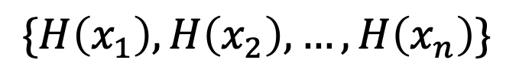
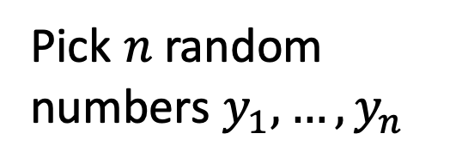
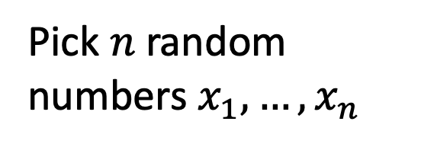
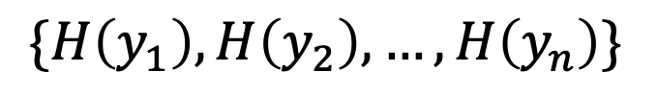
Merkle’s Idea
$\{H\left(x_{1}\right),H\left(x_{2}\right),…,H\left(x_{n}\right)\}$
$\{H\left(y_{1}\right),H\left(y_{2}\right),…,H\left(y_{n}\right)\}$
Pick $n$ random numbers $x_{1},…,x_{n}$
Pick $n$ random numbers $y_{1},…,y_{n}$
Assume that $H:\left[n^{2}\right]→[n^{2}]$ is an injective OWF.

Slide 20

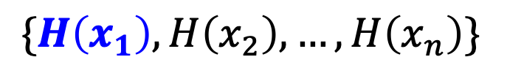

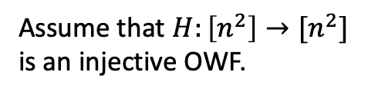
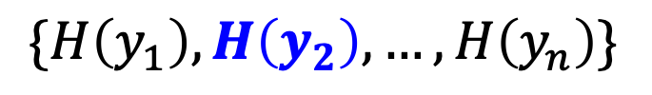
Assume that $H:\left[n^{2}\right]→[n^{2}]$ is an injective OWF.
Merkle’s Idea
$\{H\left(x_{1}\right),H\left(x_{2}\right),…,H\left(x_{n}\right)\}$
$\{H\left(y_{1}\right),H\left(y_{2}\right),…,H\left(y_{n}\right)\}$
Pick $n$ random numbers $x_{1},…,x_{n}$
Pick $n$ random numbers $y_{1},…,y_{n}$
There is a common number (say $x_{i}=y_{j}$ w.h.p.)
Alice and Bob can detect it in time $O(n)$, and they set it as their shared key.

Slide 21

Assume that $H:\left[n^{2}\right]→[n^{2}]$ is an injective OWF.
Merkle’s Idea
$\{H\left(x_{1}\right),H\left(x_{2}\right),…,H\left(x_{n}\right)\}$
$\{H\left(y_{1}\right),H\left(y_{2}\right),…,H\left(y_{n}\right)\}$
Pick $n$ random numbers $x_{1},…,x_{n}$
Pick $n$ random numbers $y_{1},…,y_{n}$
How long does it take Eve to compute the shared key?
She knows $i$ and $j$, but she needs to invert the OWF. Assuming the OWF is very strong, that is $Ω(n^{2})$ time!

Slide 22

Assume that $H:\left[n^{2}\right]→[n^{2}]$ is an injective OWF.
Merkle’s Idea
$\{H\left(x_{1}\right),H\left(x_{2}\right),…,H\left(x_{n}\right)\}$
$\{H\left(y_{1}\right),H\left(y_{2}\right),…,H\left(y_{n}\right)\}$
Pick $n$ random numbers $x_{1},…,x_{n}$
Pick $n$ random numbers $y_{1},…,y_{n}$
Problem: Only protects against quadratic-time Eves (still an excellent idea)

Slide 23
Diffie & Hellman 1976
Marked the birth of public-key cryptography.
Invented the Diffie-Hellman key exchange (conjectured to be secure against all poly-time attackers unlike Merkle).
Used to this day (e.g., TLS 1.3) albeit with different groups than what DH had in mind.
Turing Award 2015

Slide 24
Rivest, Shamir & Adleman 1978
Invented the RSA trapdoor permutation, public-key encryption and digital signatures.
RSA Signatures used to this day (e.g., TLS 1.3) in essentially the original form it was invented.
Turing Award 2002

Slide 25
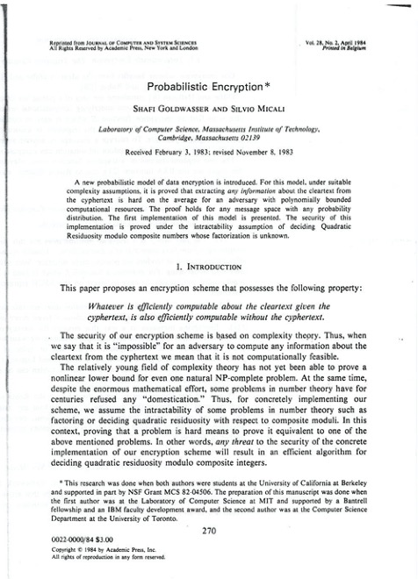
Goldwasser & Micali 1982
“Probabilistic Encryption”: defined what is now the gold-standard of security for public-key encryption (two equivalent defs: indistinguishability and semantic security)
GM-encryption: based on the difficulty of the quadratic residuosity problem, the first homomorphic encryption.
Turing Award 2012

Slide 26
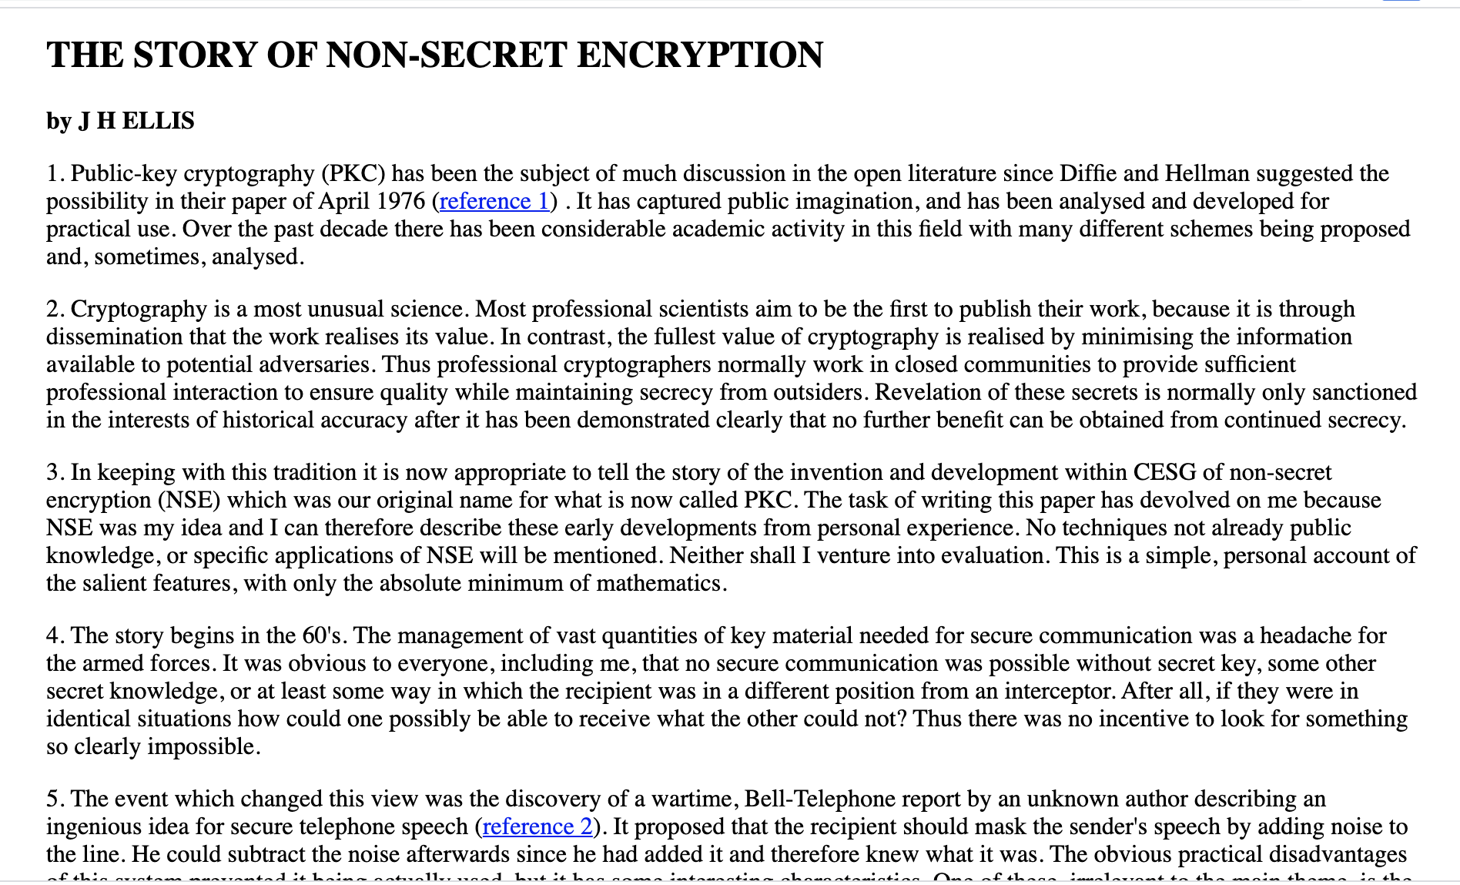
The Secret History of Public-key Encryption
Claimed to be invented in secret in early 1970s at the GCHQ (British NSA) by James Ellis, Clifford Cocks and Malcolm Williamson.

Slide 27
Public-Key Encryption
(also called asymmetric encryption)
GOAL:
Anyone can encrypt to Bob.
Bob, and only Bob, can decrypt.

Slide 28
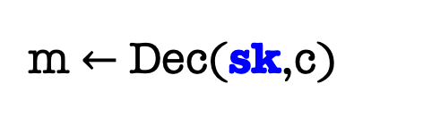
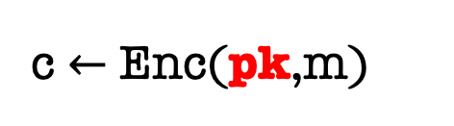
Public-Key Encryption
Bob
pk
m $←$ Dec(sk,c)
c $←$ Enc(pk,m)
sk
Bob generates a pair of keys, a public key pk, and a private (or secret) key sk.
Bob “publishes” pk and keeps sk to himself.
Alice encrypts m to Bob using pk
Bob decrypts using sk

Slide 29
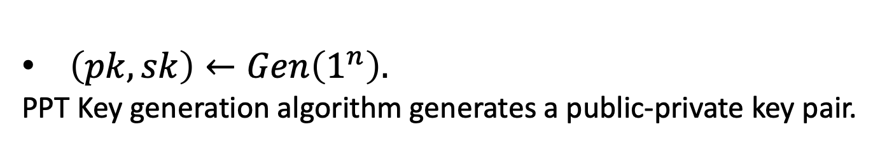
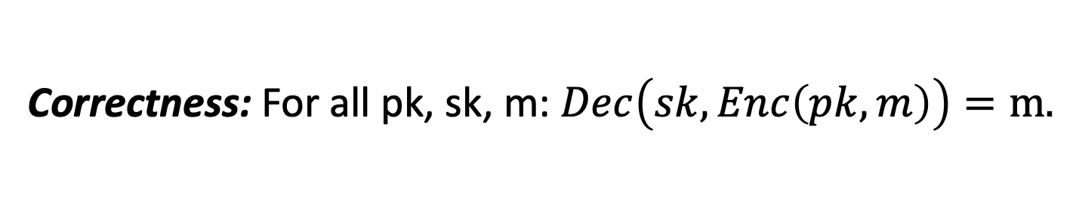
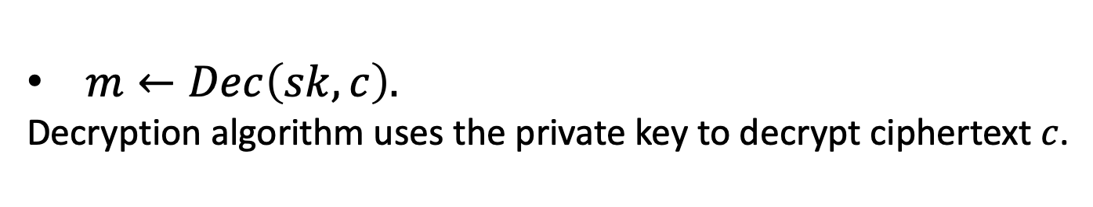
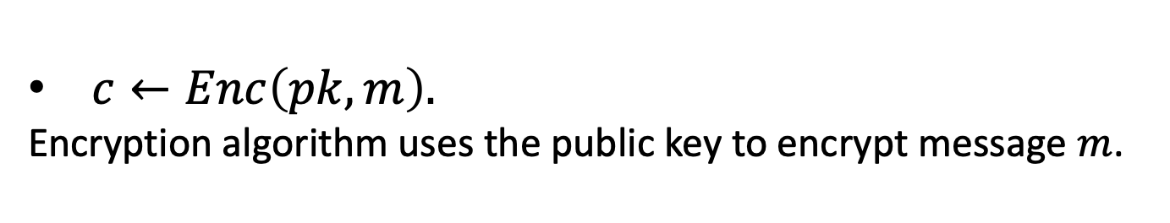
Public-Key Encryption
A triple of PPT algorithms $(Gen,Enc,Dec)$ s.t.
$\left(pk,sk\right)←Gen\left(1^{n}\right).$
PPT Key generation algorithm generates a public-private key pair.
$c←Enc\left(pk,m\right).$
Encryption algorithm uses the public key to encrypt message $m$.
$m←Dec\left(sk,c\right).$
Decryption algorithm uses the private key to decrypt ciphertext $c$.
Correctness: For all pk, sk, m: $Dec\left(sk,Enc\left(pk,m\right)\right)=m.$

Slide 30


How to Define Security
Bob
pk
c $←$ Enc(pk,m)
sk
Eve knows Bob’s public key pk
Eve sees polynomially many ciphertexts $c_{1},c_{2},…$ of messages $m_{1},m_{2},…$
Given this: Eve should not get any partial information about the set of messages.

Slide 31

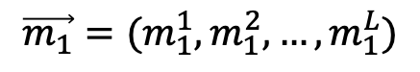
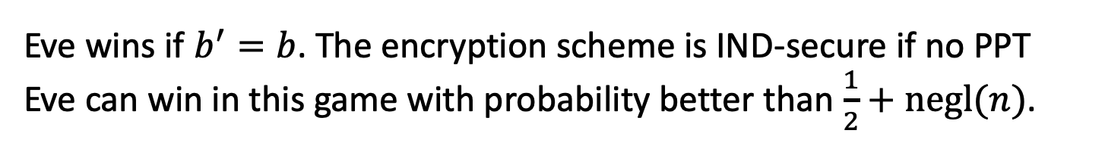
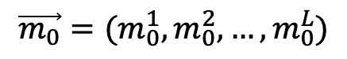
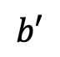
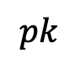
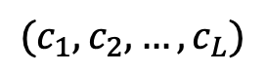
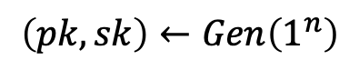
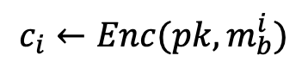
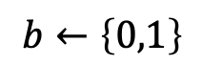

IND-Security (also called IND-CPA)
Challenger
Eve
$$\left(pk,sk\right)←Gen\left(1^{n}\right)$$
$$pk$$
$$\vec{m_{0}}=(m_{0}^{1},m_{0}^{2},…,m_{0}^{L})$$
$$s.t. \left|m_{0}^{i}\right|= {|m}_{1}^{i}| for all i$$
$$\vec{m_{1}}=(m_{1}^{1},m_{1}^{2},…,m_{1}^{L})$$
$$b←\left\{0,1\right\}$$
$$(c_{1},c_{2},…,c_{L})$$
$$c_{i}←Enc(pk,m_{b}^{i})$$
$$b′$$
Eve wins if $b^{′}=b$. The encryption scheme is IND-secure if no PPT Eve can win in this game with probability better than $\frac{1}{2}+negl(n)$.
Notes:
Encryption has to be probabilistic.

Slide 32

IND-Security
Challenger
Eve
This can be written in the more traditional (and cumbersome) notation as below, but the game is more fun.
For all PPT pair of algorithms $\left(M,A\right)$ there is a negligible fn $μ$ s.t:
$Pr⁡[\left(pk,sk\right)←Gen\left(1^{n}\right);\left(\vec{m_{0}},\vec{m_{1}} ,state\right)←M\left(pk\right) s.t.\left|m_{0}^{i}\right|= {|m}_{1}^{i}|;b ←\left\{0,1\right\}, \vec{c}←Enc(pk,\vec{m_{b}}): A(state,$ $\vec{c})=b]$
$≤\frac{1}{2}+$ $μ(n)$

Slide 33
An Alternative Definition
“Semantic Security”: the computational analog of Shannon’s perfect secrecy definition.
Turns out to be equivalent to IND-security (just as in Lec 1 but the proof is more complex)
We will stick to IND-security as it’s easy to work with.

Slide 34









Simplifying the Definition: One Message to Many Message Security
Challenger
Eve
$$\left(pk,sk\right)←Gen\left(1^{n}\right)$$
$$pk$$
$$m_{0},m_{1}$$
$$s.t. \left|m_{0}\right|=|m_{1}|$$
$$b←\left\{0,1\right\}$$
$$c$$
$$c←Enc(pk,m_{b};r)$$
$$b′$$
Eve wins if $b^{′}=b$. The encryption scheme is single-message-IND-secure if no PPT Eve can win with prob. better than $\frac{1}{2}+negl(n)$.

Slide 35



Simplifying the Definition: One Message to Many Message Security
Challenger
Eve
$$\left(pk,sk\right)←Gen\left(1^{n}\right)$$
$$pk$$
$$m_{0},m_{1}$$
$$s.t. \left|m_{0}\right|=|m_{1}|$$
$$b←\left\{0,1\right\}$$
$$c$$
$$c←Enc(pk,m_{b})$$
$$b′$$
Theorem: A public-key encryption scheme is IND-secure iff it is single-message IND-secure.
Notes:
Proof by hybrud argument
It is crucial that this is a public key scheme. For secret key schemes this theorem is simply not true. Think one-time pad.

Slide 36
Constructions of Public-key Encryption
1: Diffie-Hellman/El Gamal
2: Trapdoor Permutations (RSA)
3: Quadratic Residuosity/Goldwasser-Micali
4: Learning with Errors/Regev

Slide 37




Groups
Group $G$: (finite set $S,$ group operation $∗:S×S→S$)
Associative: $\left(g_{1}∗g_{2}\right)∗g_{3}=g_{1}∗\left(g_{2}∗g_{3}\right)$
Commutative: $g_{1}∗g_{2}=g_{2}∗g_{1}$
Identity: $Id∗g=g∗Id=g$
Inverse: for every $g$, there is a $g′$ s.t. $g∗g^{′}=g^{′}∗g=Id$

Slide 38




Order
Order of a Group $G$ = $(S,$ $∗)$ is simply $\left|S\right|$ (sometimes we will just write $|G|$).
Order of an element $g∈G$ , denoted $ord(g)$ is the minimum $n>0$ s.t.
$$g∗g∗…∗g=Id$$
Lagrange’s Theorem: $ord(g)$ always divides $\left|G\right|.$
A generator is an element of order $\left|G\right|.$
A cyclic group is one that has a generator.

Slide 39



The Additive Group $ℤ_{N}$
$ℤ_{N}$: ($\{0,1,…,N−1\},$ group operation: + mod $N$)
Order? $N$
Generators?
Every x that is relatively prime to N is a generator.

Slide 40


The Additive Group $ℤ_{N}$
$ℤ_{N}$: ($\{0,1,…,N−1\},$ group operation: + mod $N$)
Computing the group operation is easy
($=poly(\log{N)}$ time).
Computing inverses is easy.
Iterated group operations (“exponentiation”) is easy.
Given $g∈ℤ_{N}$ and $n∈ℤ$, compute $g+g+…+g$
$n$ times

Slide 41



The Additive Group $ℤ_{N}$
$ℤ_{N}$: ($\{0,1,…,N−1\},$ group operation: + mod $N$)
Computing the group operation is easy (=poly time).
Computing inverses is easy.
Exponentiation is easy.
The discrete logarithm problem is easy.
Given $g,h∈ℤ_{p},$find $n∈ℤ$, s.t. $h=g+g+…+g$
$n$ times
$$=ng (mod N)$$
Extended Euclidean algorithm: $n=hg^{−1}(mod N)$

Slide 42



The Multiplicative Group $ℤ_{p}^{∗}$
$ℤ_{p}^{∗}$: ($\{1,…,p−1\},$ group operation: $∙$ mod $p$): p prime
Order the group $=φ\left(p\right)=p−1$
(Euler’s totient function $φ\left(N\right)=|\left\{1≤x<N:gcd\left(x,N\right)=1\right\}|$
If p is prime, $ℤ_{p}^{∗}$ is cyclic.

Slide 43




The Multiplicative Group $ℤ_{p}^{∗}$
$ℤ_{p}^{∗}$: ($\{1,…,p−1\},$ group operation: $∙$ mod $p$)
Computing the group operation is easy.
Computing inverses is easy: Extended Euclid.
Exponentiation (given ${g∈ℤ}_{p}^{∗}$and $x∈ℤ_{p−1}$, find $g^{x}$ mod p) is easy: Repeated Squaring Algorithm.
The discrete logarithm problem given ${g,h∈ℤ}_{p}^{∗}$, find $x∈ℤ_{p−1}$ s.t. $h=g^{x}$ mod p) is hard, to the best of our knowledge!

Slide 44
Diffie-Hellman Key Exchange
Commutativity in the exponent:
$$(g^{x})^{y} =$$
$${(g}^{y})^{x}$$
(where $g$ is an element of some group)
So, you can compute $g^{xy}$given either $g^{x}$and $y$, or $g^{y}$and $x.$
Diffie-Hellman Assumption (DHA):
Hard to compute $g^{xy}$ given only ${g, g}^{x}$ and $g^{y}$

Slide 45

Diffie-Hellman Key Exchange
Diffie-Hellman Assumption (DHA):
Hard to compute it given only ${g,g}^{x}$ and $g^{y}$
We know that if discrete log is easy, DHA is false.
Major Open Problem: Are discrete log and DHA equivalent?

Slide 46
Diffie-Hellman Key Exchange
$p,g:$ Generator of our group $Z_{p}^{∗}$
$$g^{x} mod p$$
$$g^{y} mod p$$
Pick a random number $x∈Z_{p−1}^{}$
Pick a random number $y∈Z_{p−1}^{}$
Shared key K = $g^{xy} mod p$
Shared key K = $g^{xy} mod p$
= ${(g}^{y})^{x} mod p$
= ${(g}^{x})^{y} mod p$

Slide 47
Diffie-Hellman/El Gamal Encryption
$Gen\left(1^{n}\right):$Generate an $n$-bit prime $p$ and a generator $g$ of $Z_{p}^{∗}$. Choose a random number $x∈Z_{p−1}^{}$ Let $pk=(p,g,g^{x})$ and let $sk=x$.
$Enc\left(pk,m\right)$ where $m∈Z_{p}^{∗}$: Generate random $y∈Z_{p−1}^{}$and output $(g^{y},g^{xy}∙m$)
$Dec\left(sk=x,c\right)$: Compute $g^{xy}$ using $g^{y}$ and $x$ and divide the second component to retrieve $m$.
How to make this really work?
Is this Secure?

Slide 48




How to come up with a prime p
How to come up with a group $ℤ_{p}^{∗}=$ how to generate a large prime $p$?
(1) Prime number theorem: $≈1/n$ fraction of $n$-bit numbers are prime.
(2) Primality tests [Miller’76, Rabin’80, Agrawal-Kayal-Saxena’02] Can test in time $poly(n)$ if a given $n$-bit number is prime.

Slide 49



How to come up with a generator g
If p is prime, $ℤ_{p}^{∗}$ is cyclic (so generators exist).
How to come up with a generator of $ℤ_{p}^{∗}$?
(1) There are lots of generators: $≈1/n$ fraction of $n$-bit numbers are prime.
(2) Testing if $g$ is a generator:
Theorem: let $q_{1},…,q_{k}$ be the prime factors of $p$. Then, g is a generator of $ℤ_{p}^{∗}$ if and only if $g^{(p−1)/q_{i}}≠1 (mod p)$ for all i.

Slide 50

To Summarize
Pick a random prime p together with its prime factorization (Adam Kalai 2000 paper)
Pick a random element of $ℤ_{p}^{∗}$ and test if it is a generator (using theorem from last slide).
Continue this process until you hit a generator. The density of generators is large enough that this will converge in expected poly(log p) time.
Another, more commonly used method, in the next lecture.

Slide 51
Next Lecture: More on Diffie-Hellman Key Exchange

